Slide 1


PPES Philosophy, Political Science, Economics and Sociology
Dr Elaine Moriarty
Open Day
Saturday 23 March, 2024
Trinity College Dublin, The University of Dublin

Slide 2
Purpose of this talk…
Welcome to Trinity
Introduce you to PPES
Discuss the individual disciplines which contribute to the PPES programme
Highlight the career options open to you at the end of four years of study in PPES
Why Trinity?

Slide 3

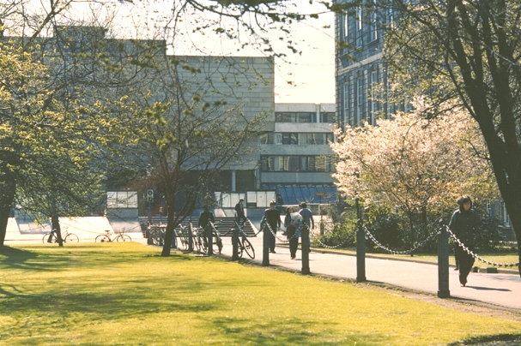
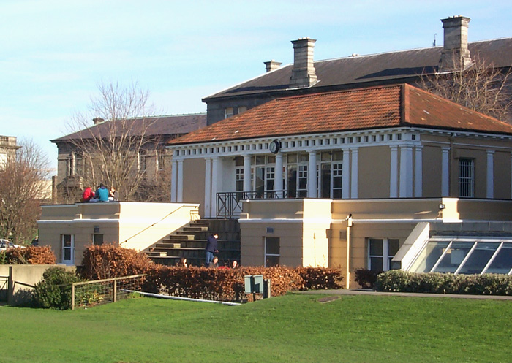


Trinity College… Founded in 1592
A University of Global Consequence
Leading Irish Research University
Global Recognition
Ranked 1st in Ireland and 101st in the World
(QS World University Ranking)

Slide 4
The Trinity PPES programme…unique in Ireland
School of Social Sciences and Philosophy
Philosophy
Sociology
Political Science
Economics

Slide 5



Philosophy
Philosophy examines fundamental issues such as ethics, morality and justice.
Students will
study works of famous philosophers and their impact on the development of civilization
explore the history of philosophical thought and its influence on modern society
question assumptions, and articulate own point of view carefully and thoughtfully.

Slide 6
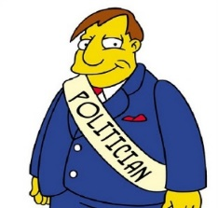


Political Science
The scientific study of politics, the exercise of power and the workings of democratic political institutions
Students will learn about
  How democracy works
  How people vote
  How political parties compete
  How European integration works
  The values behind political ideologies

Slide 7


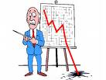
Economics
Develops the concepts and tools to understand:
  How to limit / prevent unemployment
  How to regulate financial markets
  How to control the market power of large firms
  How best to address climate change
  How to help poorer countries grow and develop

Slide 8
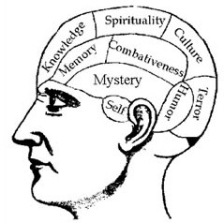


Sociology
Studies social change and social consequences of human behaviour. Understand phenomena such as
  Social change and how it affects individuals and groups in societies
  Inequality along lines of social class, gender, race and ethnicity
  Social movements like fair trade or feminism
  The changing world of work through digitalisation and AI.

Slide 9
What does PPES offer?
  Honors Bachelor Degree at one of the flagship programmes at Trinity College Dublin
  Only university degree in Ireland where students can combine the study of Philosophy, Political Science, Economics and Sociology
  Flexible pathway programme with multiple degree options across these four subjects
  Opportunity to study abroad at distinguished partner universities in Europe and the World

Slide 10
Single Honor Degrees
Joint Honor
Major with Minor
Joint Honor Degrees
Philosophy and Economics
Philosophy and Political Science
Sociology and Philosophy
Economics and Political Science
Economics and Sociology
Political Science and Sociology
Single Honor Degrees
Economics
Political Science
Philosophy
Sociology
Major/ Minor Degrees
Manjor Sociology / Minor Political Science
Major Philosophy/ Minor Economics
Major Philosophy/ Minor Political Science
Major Economics / Minor Philosophy
Major Economics / Minor Political Science
Major Sociology / Minor Philosophy
Major Economics / Minor Sociology
Major Political Science / Minor Economics
Major Political Science / Minor Philosophy
Major Political Science/ Minor Sociology
Major Sociology/ Minor Economics
Major Philosophy/ Minor Sociology

Slide 11

What will I study? Overview
  Start with a grounding in all four subjects
  Then continue with those that interest you
  In the last two years choose the modules that interest you in one or two subjects
  The final year you’ll also do a large independent project using the skills and knowledge you’ve gained
  Plus there’s the opportunity to study abroad in third year

Slide 12
Junior Fresh – Year 1
Six compulsory modules from all four subjects:
  Philosophy
  Political Science
  Economics
  Sociology
-You don’t need previous training in these disciplines
-Lots of complementarity
Philosophy
Central problems in Philosophy History of Philosophy
Politics
Introduction to Political Science
Economics
Introduction to Economics Mathematics and Statistics
Sociology
Introduction to Sociology

Slide 13


Senior Fresh – Year 2
Examples of courses within four disciplines:
Philosophy
Politics
History of Philosophy II Logic, Language and Science
History of Political Thought International Relations
Comparative Politics
Economics
Sociology
Intermediate Economics Mathematical & Statistical
Methods
Introduction to Social Research European Societies
Gender, Work and Family
Power, State and Social Movements
(
OPTIONAL: FOUNDATION SCHOLARSHIP

Slide 14


Junior Sophister – Year 3
Examples of courses within four disciplines:
Philosophy
Political Philosophy
Topics in Ancient in Philosophy Topics in Analytic Philosophy Moral Philosophy
Philosophy of Religion Metaphysics
Topics in Continental Philosophy
Political Science
Research Methods for Political
Scientists
American Political Institutions
Irish Politics
Democracy & Development Political Violence
Economics
Sociology
Econometrics Mathematical Economics Economics of Public Policy European Economics Money and Banking Financial Economics
Understanding Social Change: Irish society
Globalisation and Development Researching Society
Race, Ethnicity and Identity
Social Inequality
OPTIONAL: STUDY ABROAD/INTERNSHIP

Slide 15

Study Abroad Destinations

Slide 16
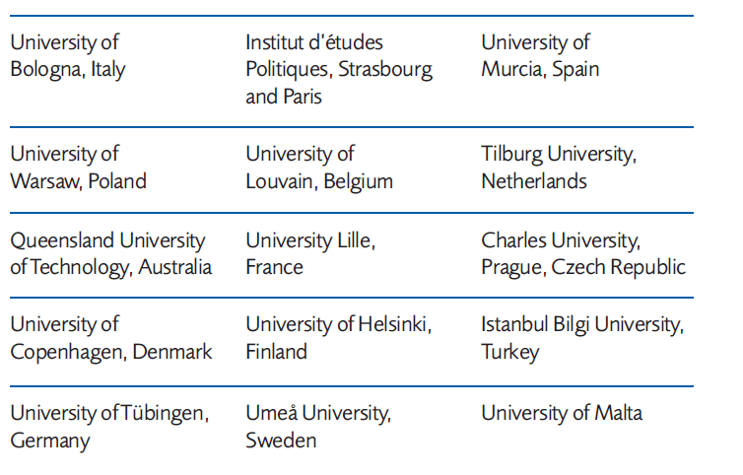
International study opportunities
The PPES programme actively promotes student mobility in the Junior Sophister year

Slide 17
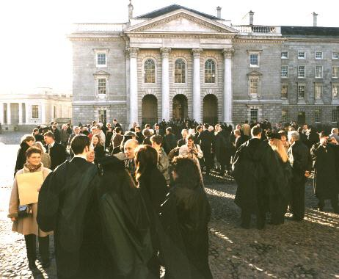
Senior Sophister – Year 4
Specialise in one (Single honor) or two (Joint honors/Major with Minor) subjects
Capstone Project: Independent Project

Slide 18
Your Tutor – Unique to TCD
Confidential help and advice
Support and defend your point of view
For example:
  course choices
  exam results
  family conflicts
  bereavement
  taking a year out

Slide 19

The Trinity Experience
https://www.tcd.ie/students/clubs-societies/
Wider student life is important, and PPES provides plenty of scope for engagement in a wide range of activities.
50 sports clubs, 120 societies.
Some societies seem particularly suited to
PPES Students
DUBES – Dublin University Business & Economic Society | Political Science Society | Social Studies Society
AIESEC | Foresight | Enterprise Trinity
Upstart | Mature Students Society

Slide 20










Your future employment
Public service
Management consulting
Economic and political journalism
Broadcasting
Banking and Finance
Economic, social and political research
Law
Social work and counselling
Advertising
Employers come to TCD

Slide 21
CAO details
Course code TR015
Leaving Cert OC3/HD3 Mathematics
No need to have studied any subject before
34 places

Slide 22
Why study PPES at Trinity?
It’s the only place you can!
Small group
Ireland’s premier university
International reputation
Degree flexibility

Slide 23
Thank you
Trinity College Dublin, The University of Dublin

